Slide 1
Metric Learning
Optimization Seminar
Presented by:
Mahya Mohammadi kashani
Professor :
Dr Seyed Hamid Amiri
June 2017

Slide 2
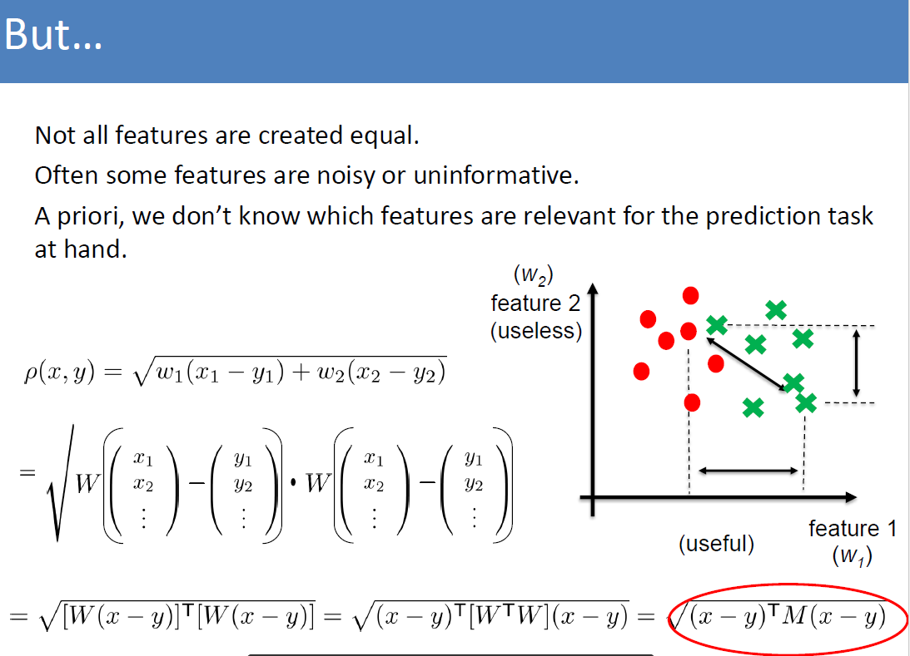
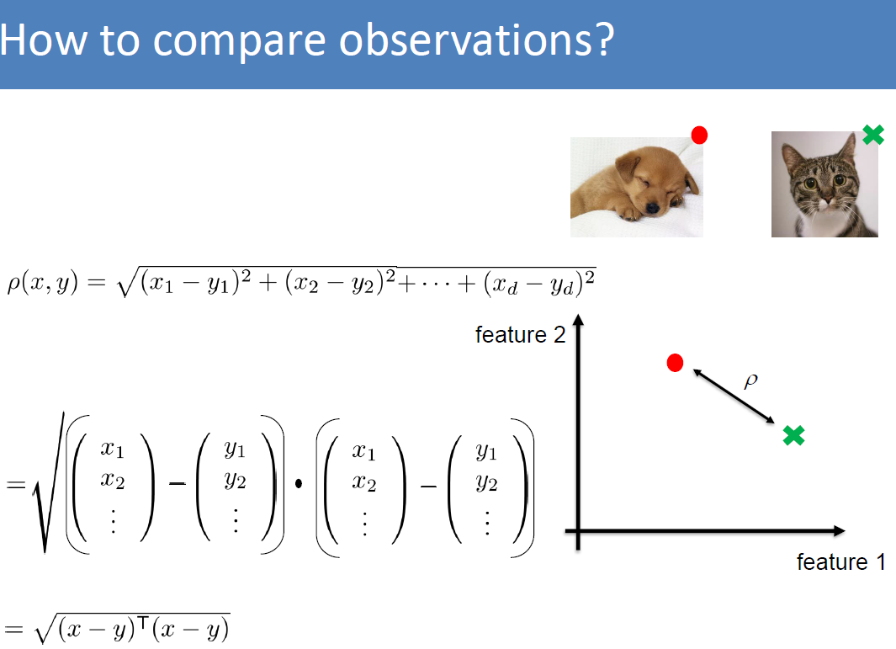
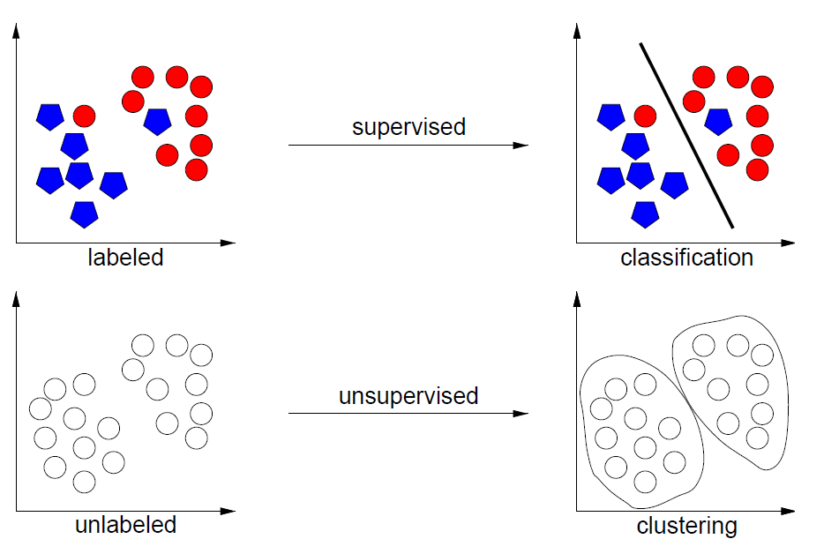
Machine Learning
Data
Learning
Model
Tutorial on Metric Learning (Bellet 2013)

Slide 3
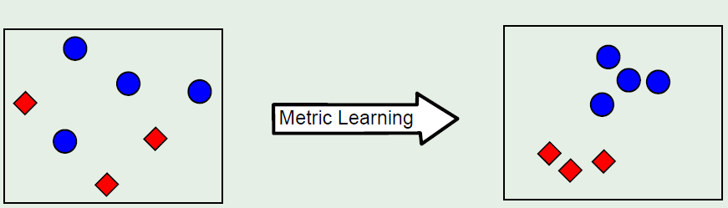
Metric learning: Adapt the metric to the problem of interest
The notion of good metric is problem-dependent
Each problem has its own semantic notion of similarity, which is often
badly captured by standard metrics (e.g., Euclidean distance)
Solution : learn the metric from data
Basic idea?
Fig.3. Tutorial on Metric Learning(Bellet,2013)

Slide 4
metric
Definition (Distance function)
A distance over a set X is a pairwise function which
satisfies the following properties :
(non negativity)
If and only if (identity of indiscernible),
(symmetry)
(triangle inequality)
Definition (Similarity function)
A (dis)similarity function is a pairwise function . K is symmetric
if

Slide 5
So what is metric learning?
Given data of interest, learn a metric (M), which helps in the prediction task.
How?
Given some annotated data, want to find an M such that examples from the same class get small distance than examples from opposite class.
So:
Create an appropriate optimization problem and optimize for M!

Slide 6
The basic optimization
Attempt: Let’s create two sets of pairs: similar set S, dissimilar set D.
want M such that: large, for
small, for
Create cost/energy function:
Minimize with respect to M!

Slide 7
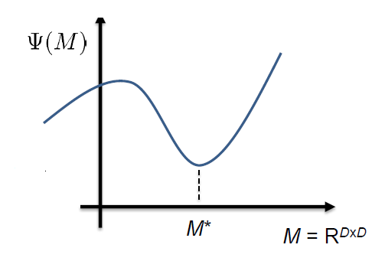
How do we minimize?
Its an optimization problem!
Take the gradient
Find the stationary points
Things to consider:
There are constraints
The function is high dimensional

Slide 8
Mahalanobis distance learning
The Mahalanobis (pseudo) distance is defined as follows:
Where is a symmetric Positive semi definite matrix!
Equivalent to a Euclidean distance after a linear projection L :
If M has rank k, (dimensionality reduction)

Slide 9
Mahalanobis distance learning 2
formulation
Advantages:
Problem formulation is convex, so efficiently solvable!
Tight convex clusters, can help in clustering!

Slide 10

Solution problem approach
The case of diagonal M
We want to learn M with Newton Method
The case of full M
In the case of full M, newton method becomes expensive (require(O($n^{6})$) time to invert Hessian ) then what to do?

Slide 11
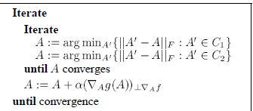
In the case of full M
Using Gradient ascent + Iterative projection algorithm
Recall :
Xing et al.,2002

Slide 12
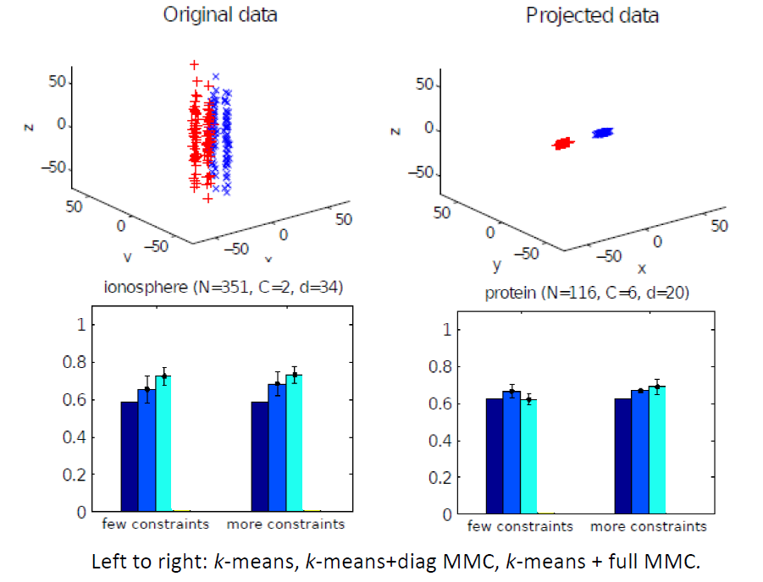
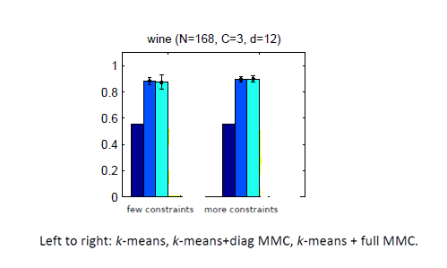
Empirical performance
Finding a rescaling of the data
That hopefully the similar pairs data together.
Xing et al.,2002

Slide 13
Applications
Classification: k-Nearest Neighbors, Support Vector Machines...
Clustering: K-Means and its variants.
Information Retrieval / Ranking: search by query, image retrieval...
Data visualization in high dimensions.
Computer Vision: compare images or videos in ad-hoc representations. Used in image classification, object/face recognition,
tracking, image annotation...
Bioinformatics: compare structured objects such as DNA sequences or temporal series.

Slide 14
Conclusion
Learns a distance metric that respects these relationships.
method is based on posing metric learning as a convex optimization problem which allowed to derive efficient, local optima free algorithms.
The advantage of Mahalanobis metric learning is convex problem and solvable but if dimension of M be large, the bottleneck is the projection on the set M

Slide 15
Reference
[1] Tutorial on Metric Learning, Aurelien Bellet, Department of Computer Science, Viterbi School of Engineering, University of Southern California,2013
[2] A tutorial on Metric Learning with some recent advances, Nakul Verma ,2014,HMMI
[3] Distance metric learning, with application to clustering with side-information, Xing et al., NIPS

Slide 16
Thank You
Thanks for your attention☺

Slide 17
Any Question?

